Slide 1
FIT3179 Data Visualisation
MONASH INFORMATION
TECHNOLOGY
Week 07: Visualisation tools

Slide 2
Visualisation tools overview

Slide 3
Visualisation tools
In this subject we’re mostly designing using Tableau, but it isn’t the only choice available.
Typically as a visualiser you want to pick the most appropriate tool for the job.
Since you know Tableau this it will probably be your first choice
If you want to do visualisation as a career, there are other industry-standard approaches

Slide 4
Visualisation tools for every step
In creating a visualisation, the available tools can be roughly grouped into three main categories
Data collection, checking and reformatting
Data analysis and design of the basic visualisation
Final tweaking of the design
Each of these stages have different tools. Additionally, different types of visualisations have different tools that are best for the job.

Slide 5
Main Tools
Stage | Free Tools | Paid Tools
Data Preparation | Python, PHP, Mr Data Converter, Mr People
Analysis & Visualisation | Tableau Public, IBM Many Eyes, Raw, Dygraphs, Wolfram Alpha, jqPlot | Excel, Tableau, Spotfire, Qlikview, MS BI Stack
Interactive Visualisation Programming | D3.js, ProtoVis, R & Shiny, Google Charts, Leaflet, Vega, Chart.js, Zinggraph, InstantAtlas, Timeline
Final Presentation | Inkscape | Illustrator, Powerpoint
GIS, web maps | QGIS, Leaflet | ArcGIS
This is not an exhaustive list! There are lots of different programming libraries (mostly js based) and software. You can find an incomplete list at: https://en.wikipedia.org/wiki/Category:Data_visualization_software

Slide 6
Visualisation tools
This week we look at alternative visualisation tools.
We’ll start at the most basic and work our way to the more complicated options.

Slide 7
Excel
We can create visualisations directly in Excel.
Generally simple visualisation types
Not many items/options to choose from
Good enough for simple visualisations though!

Slide 8
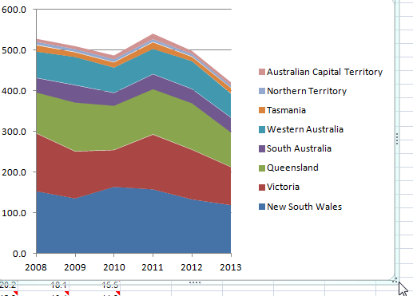
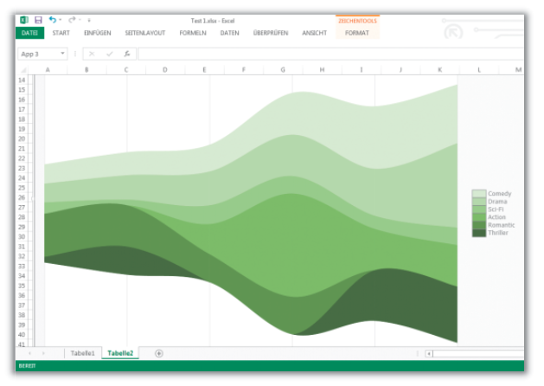
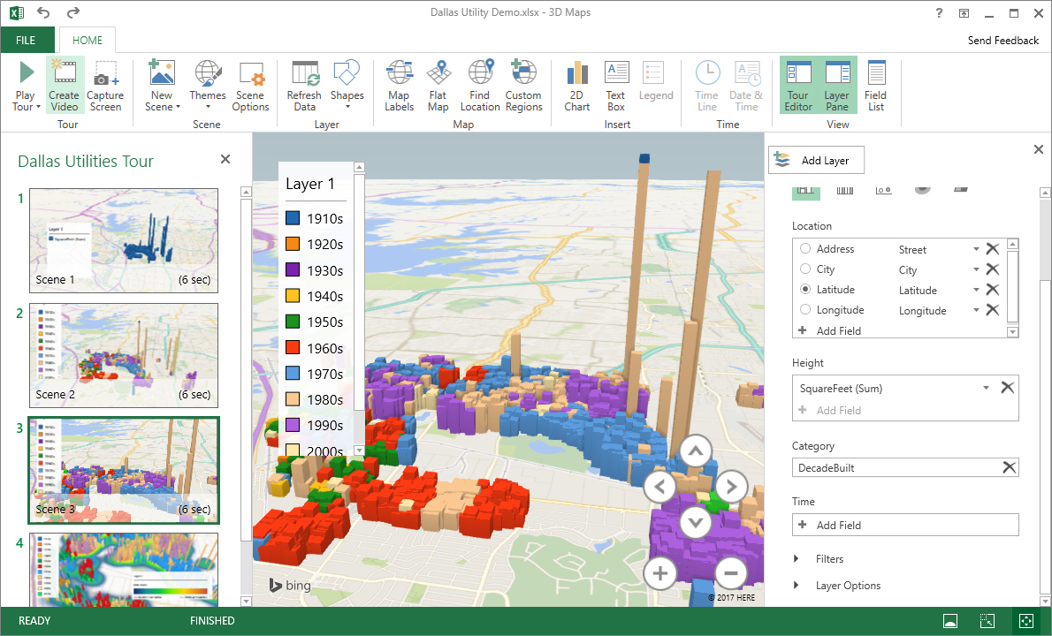
Excel demonstration

Slide 9
Google Charts
Similar to Excel, we can make visualisation charts using data in a Google spreadsheet
Generally very simple visualisation types as well
The ‘basic’ chart is almost the same as Excel
BUT, we can also use JavaScript and Google chart libraries to create more interactive and better versions on separate webpages
This gives us the benefit of having a visualisation where the data is driven dynamically by the spreadsheet
If we change the spreadsheet, the visualisation will change (when reloaded)

Slide 10
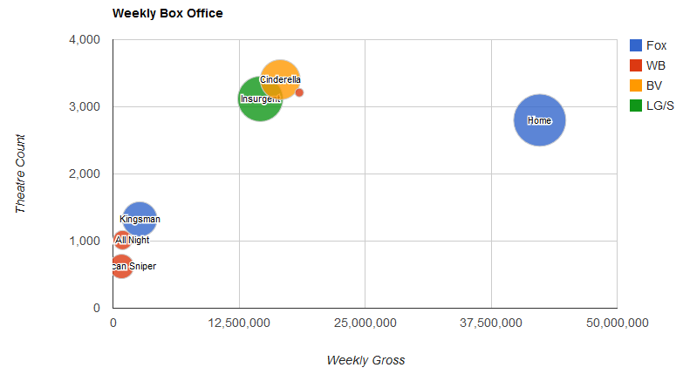
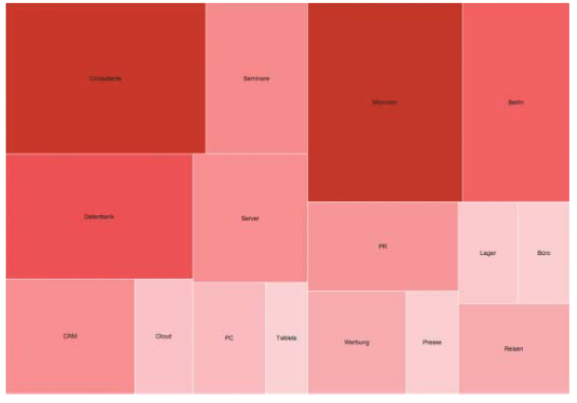
Google Charts

Slide 11
Leaflet
Similar to programming with JavaScript and Google charts, Leaflet is a JavaScript library we can use to program html pages to show visualisations
Is only used for maps
Is a fairly common library to use (smaller and more flexible than the Google maps API)
Used by FourSquare, Pinterest & Flickr
http://leafletjs.com
Side note: https://www.openstreetmap.org and iD editor

Slide 12
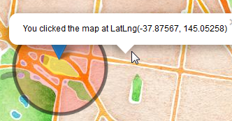
Leaflet demonstration

Slide 13
D3.js
D3.js is a JavaScript library. D3 (Data Driven Documents) is very popular amongst visualisation experts because it is flexible and allows huge control over the final result.
Low level, not simple, but very powerful
Can bind data to the Document Object Model (DOM) and apply transforms to the document based on the data
Translation: Allows us to generate or change HTML web pages based on a dataset
Uses CSS, SVG and Javascript to create the visualisation.
https://d3js.org
https://github.com/d3/d3/wiki/Gallery

Slide 14
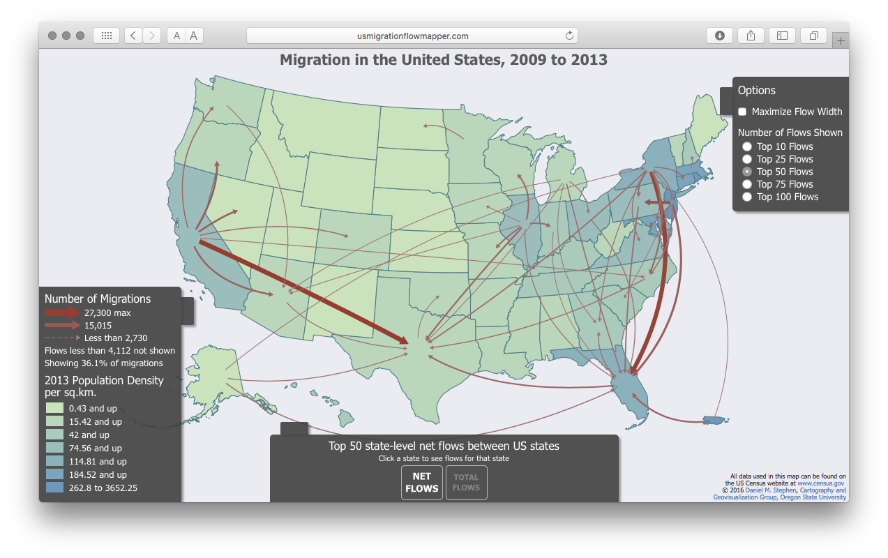
D3.js Example
Source: http://usmigrationflowmapper.com

Slide 15
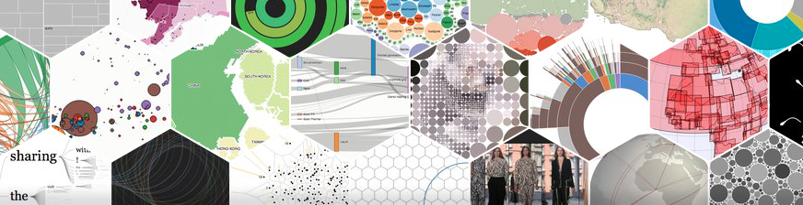
D3.js Demonstration
https://d3js.org

Slide 16
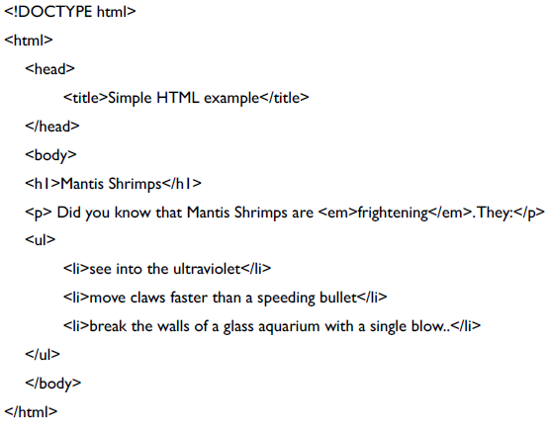
A quick primer: HTML
You’re probably familiar with some of those terms. Just in case you need a refresher, let’s just quickly go over them.
HTML: HyperText Markup Language
The coding behind webpages

Slide 17
A quick primer: DOM
DOM: Document Object Model
DOM is the hierarchical structure of HTML. We use this to access different parts of the HTML

Slide 18
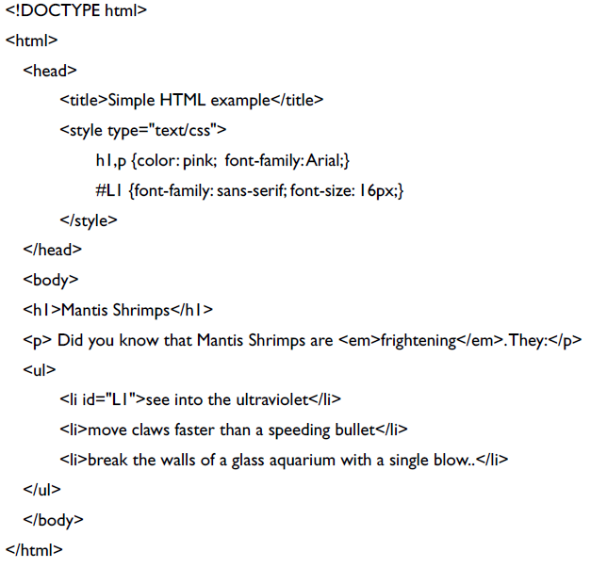
A quick primer: CSS
CSS: Cascading Style Sheets
HTML is the content, whereas CSS defines the style (size, colour, position, etc.) of the HTML elements
CSS consists of rules made of selectors and properties

Slide 19
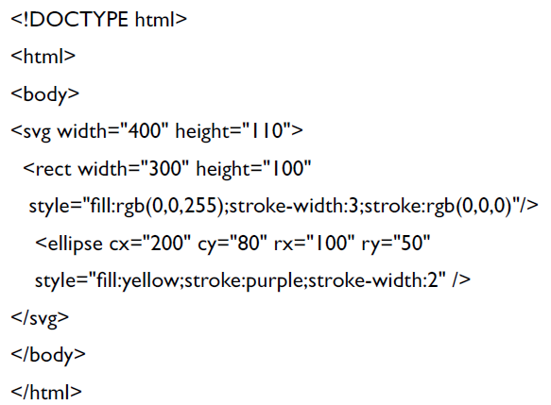
A quick primer: SVG
SVG: Scalable Vector Graphics
SVG is the web vector graphics format. It is designed to work with both HTML and CSS and can be used to draw graphic primitives (lines, circles, text, ellipses, rect, paths) onto the screen.

Slide 20
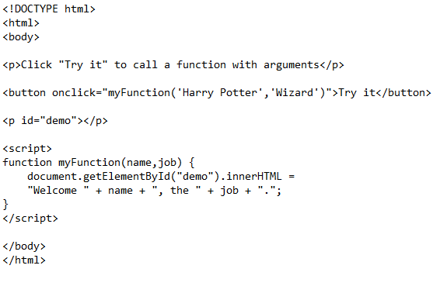
A quick primer: JavaScript
JavaScript is a scripting language that exists inside HTML and can make a web page dynamic (i.e., it runs after it is downloaded by the client) by modifying the DOM

Slide 21
D3.js and SVG
Since D3 uses SVG as its primary method of drawing to the screen, we’re really only restricted by SVG limitations in our visualisation options
You can read the huge specs for SVG here https://www.w3.org/TR/SVG/
Also a nice cheatsheet at http://www.jeromecukier.net/wp-content/uploads/2012/10/d3-cheat-sheet.pdf

Slide 22
Vega
Vega is a visualisation grammar, with declarative terms for creating visualisations
A framework to use D3.js to create the visualisation
Uses a JSON file to create visualisations
You create and share visualisations with the JSON file
Specific schema https://vega.github.io/vega/vega-schema.json
Lacks some of the flexibility and power of D3 but is easier to use

Slide 23
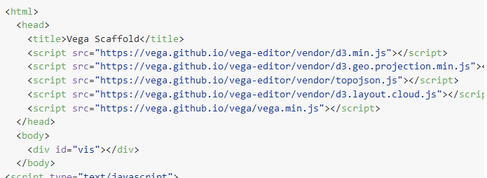
Vega embedding into HTML
The official Vega HTML embedding document shows how much it relies on a D3 backend
https://github.com/vega/vega/wiki/Runtime

Slide 24
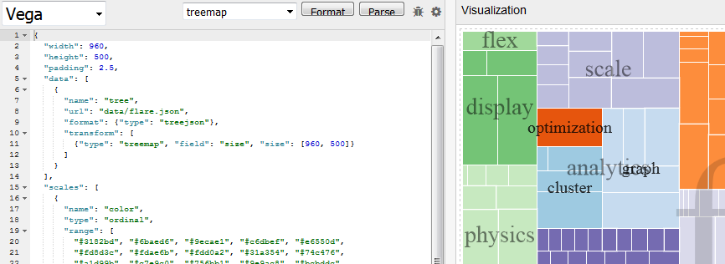
Vega Example
http://vega.github.io/vega-editor/index.html?spec=treemap

Slide 25
R
R Project for Statistical Computing
Many packages for creating different types of visualisations.
Example: Plotly https://plot.ly/r/

